Slide 1
ATM PROJECT
Group Wibu:
Nguyen Duc Tong
Quan Duc Loc
Tran Minh Thang
Dang Le Thanh Nam

Slide 2
OUTLINE
Problem Definition
Customer Requirement Specification
Project Plan
Object Oriented Diagram
Use-case diagram
Algorithms

Slide 3
I. Problem Definition
Client is identified by a unique card number (card ID / user name) and some security information
User only access after entering the correct user name, and corresponding password/PIN (Personal Identification Number - a 4-digit number)
Our goal is to create a fully functional ATM system

Slide 4
II. Customer Requirement Specification
User needs to use the password (Which user change at the very first transaction)
The ATM screen appear after input correct username and password
Each time a new user enter the ATM room, They provide their login credentials before being able to access the system.
Once the card number and password are entered the system check its availability in the database. If it is not available, generated an error message , , else user needs to enter the password again.
The password is verified, the screen appears with the main menu

Slide 5
III. Project Plan
Create classes for user authentication, data connection, storing user info and menu
The admin menu and user menu are extended from the original menu class:
There are 10 options in admin menu
There are 5 options in user menu
Create test cases to check

Slide 6
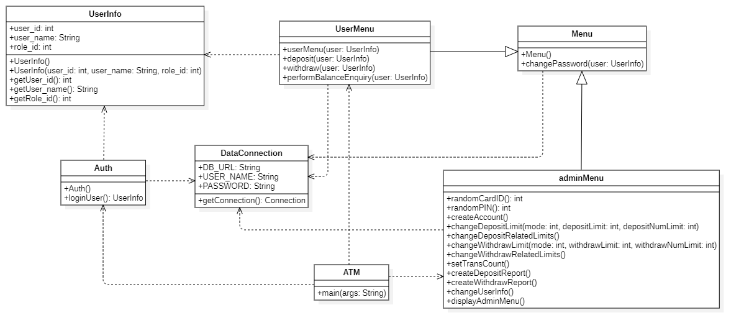
IV. Object Oriented Diagram

Slide 7
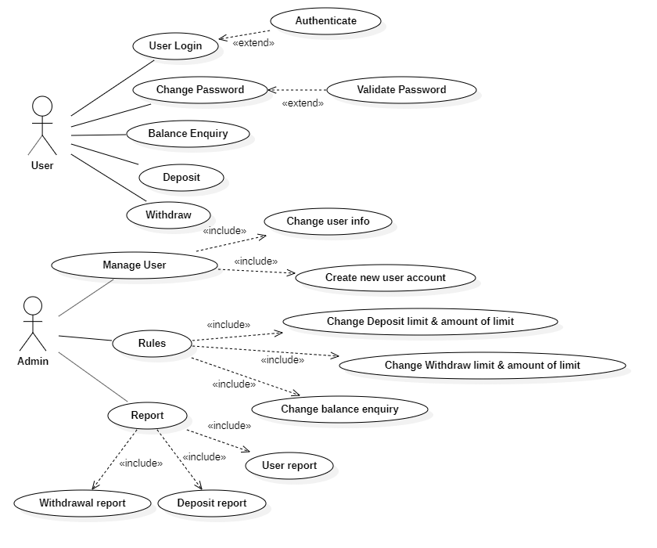
V. Use-case diagram

Slide 8
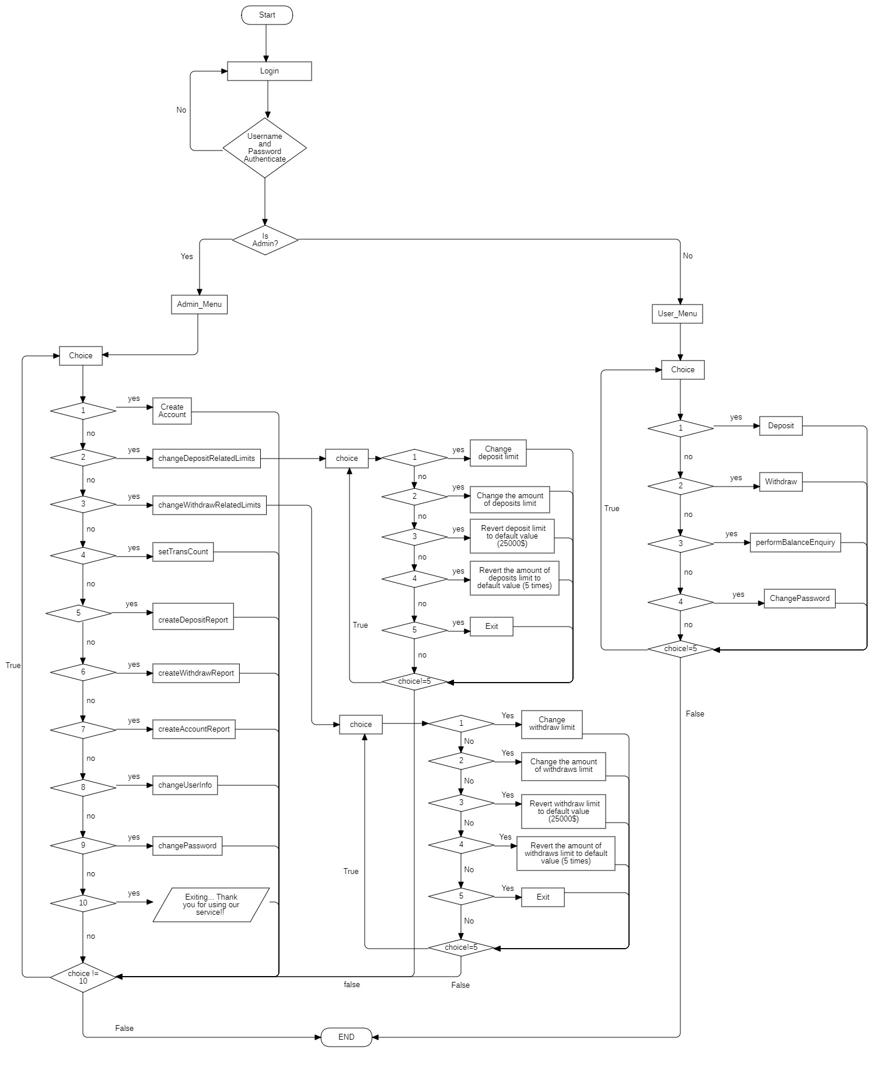
VI. Algorithm Diagram

Slide 9
VII. Project Review
The project has been essentially completed with the important functionalities all done according to the original project plan.
There are some difficulties during the working process but our group has managed to overcome all of them.
However, there are some flaws in the working process of our project

Slide 10
ThANk For
Your LISTENIng
-Wibu Team-

